Slide 1


Spend Less Going Serverless:
It’s Possible, We Swear!
X

Slide 2




Our plans for today
X
25 minutes
Cost Optimization Strategies
20 minutes
Caching?!
10 minutes
Breaking Down SwagHunt
Q & A

Slide 3

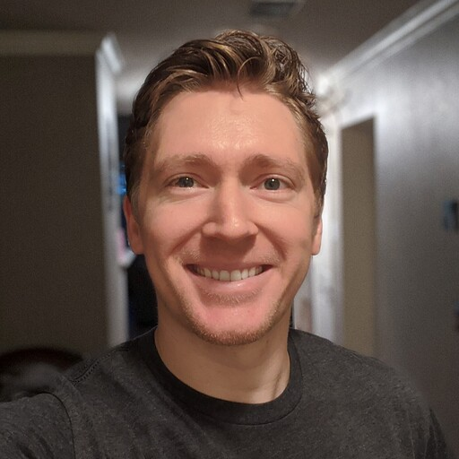


Sam Lock
Sr. Serverless Dev @ Serverless Guru
😍’s Serverless Framework
😣’s Working w/ RDS (excluding the 🤍 Aurora Data API 🤍)

Slide 4

Our Company
We love to take on challenges, face the unknown, and be on the forefront of serverless innovation.
Helping companies and people realize their full potential gives us energy.
Speak to a Guru today!

Slide 5
Cost Optimization Strategies

Slide 6
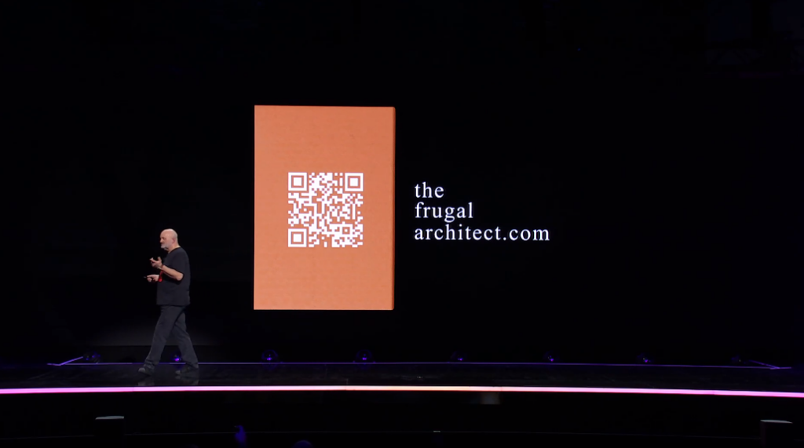

Slide 7
Total Cost Of Ownership
How much does software engineering “actually” cost?
Infrastructure costs
Maintenance costs
Development costs

Slide 8
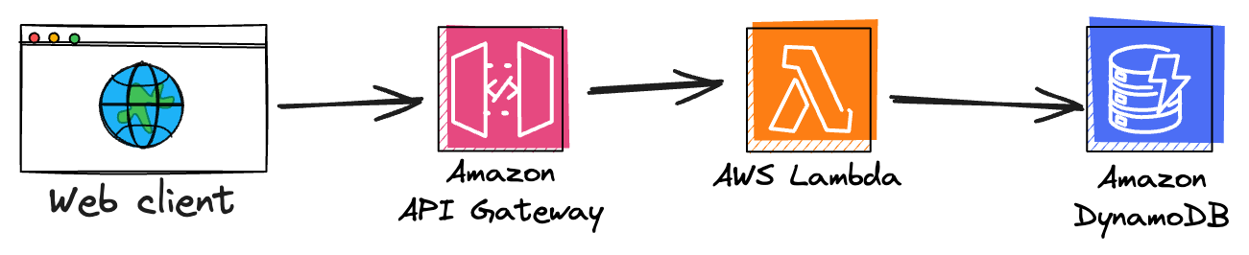
Total Cost Of Ownership
How much does software engineering “actually” cost?

Slide 9
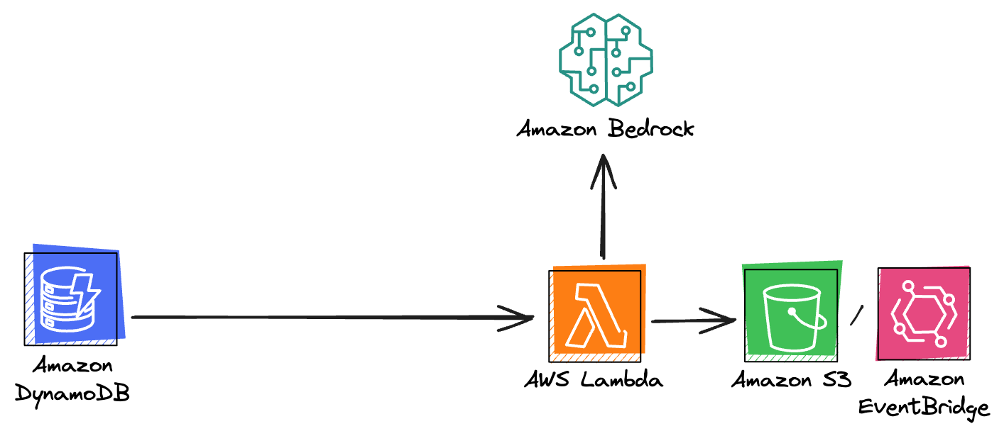
Total Cost Of Ownership
How much does software engineering “actually” cost?

Slide 10
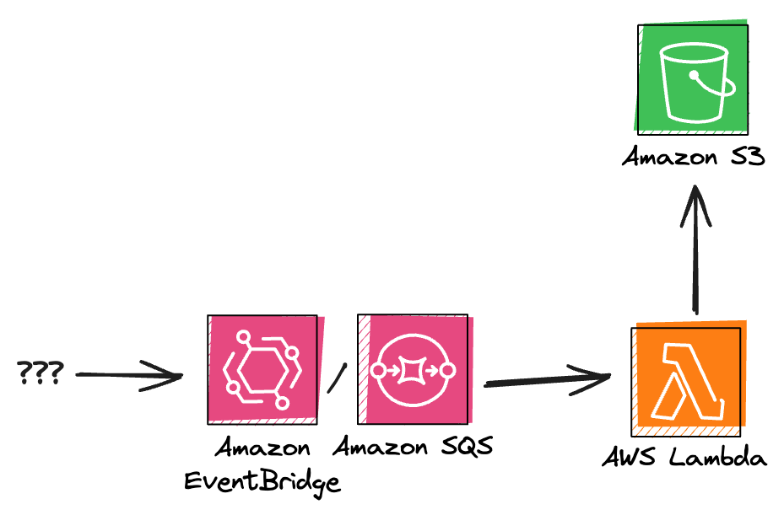
Total Cost Of Ownership
How much does software engineering “actually” cost?

Slide 11
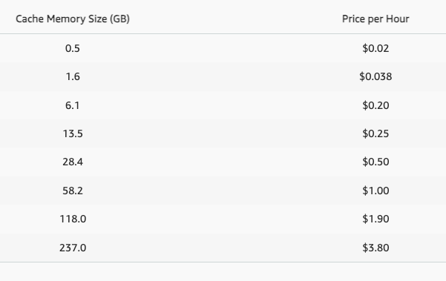
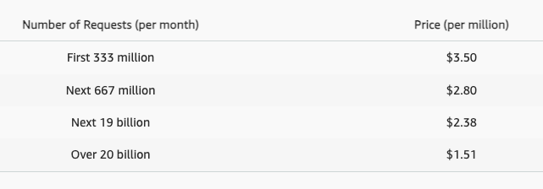
API Gateway

Slide 12
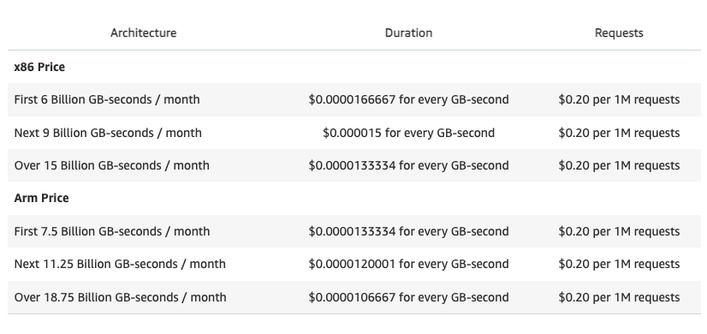
AWS Lambda

Slide 13
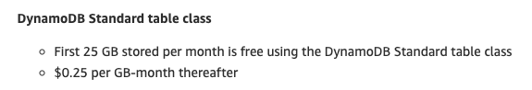
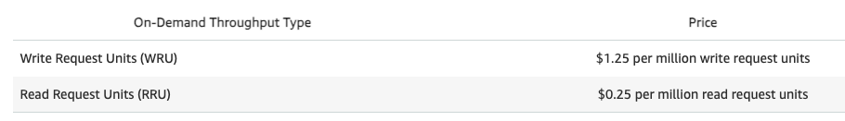
DynamoDB

Slide 14
Minimize # of requests/invocations
Minimize duration
Minimize storage
Notes:
ESBuild or Webpack can reduce size by +80%
Expire DDB items via TTL

Slide 15

Lambda Power Tuning

Slide 16
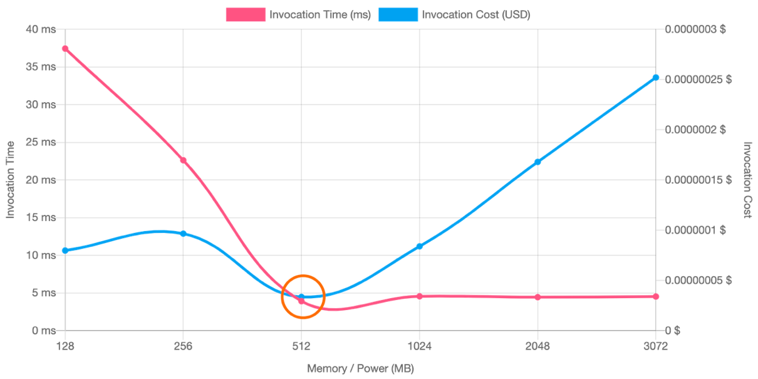
Original
Memory: 128MB
Duration: 36ms
Option A (👍):
Memory: 512MB
Duration: 4ms
Savings: +36%
Speed: +88%
Option B (👎):
Memory: 3072MB
Duration: 4.5ms
Savings: -257%
Speed: +87%
Original
Option A
Option B
https://aws.amazon.com/blogs/compute/optimizing-your-aws-lambda-costs-part-1/

Slide 17
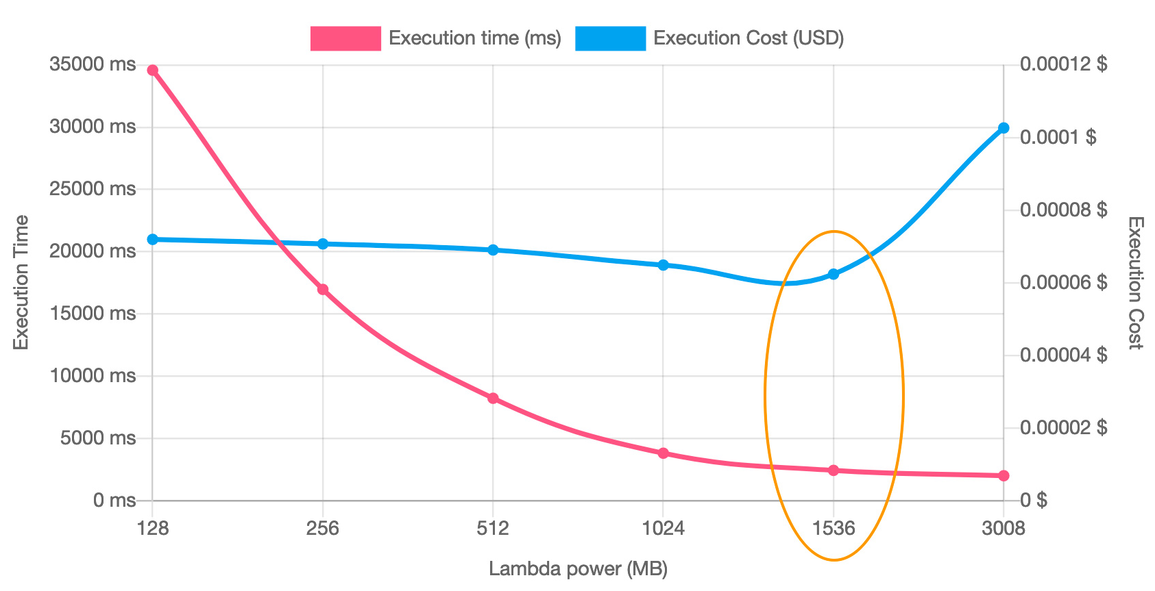
Option B
Original
Memory: 128MB
Duration: 35secs
Option A (👍):
Memory: 1536MB
Duration: 3ms
Savings: +14%
Speed: +91%
Option B (🤷):
Memory: 3008MB
Duration: 2.9ms
Savings: -66%
Speed: +92%
Option A
Original
https://aws.amazon.com/blogs/compute/optimizing-your-aws-lambda-costs-part-1/

Slide 18
DynamoDB Streams

Slide 19
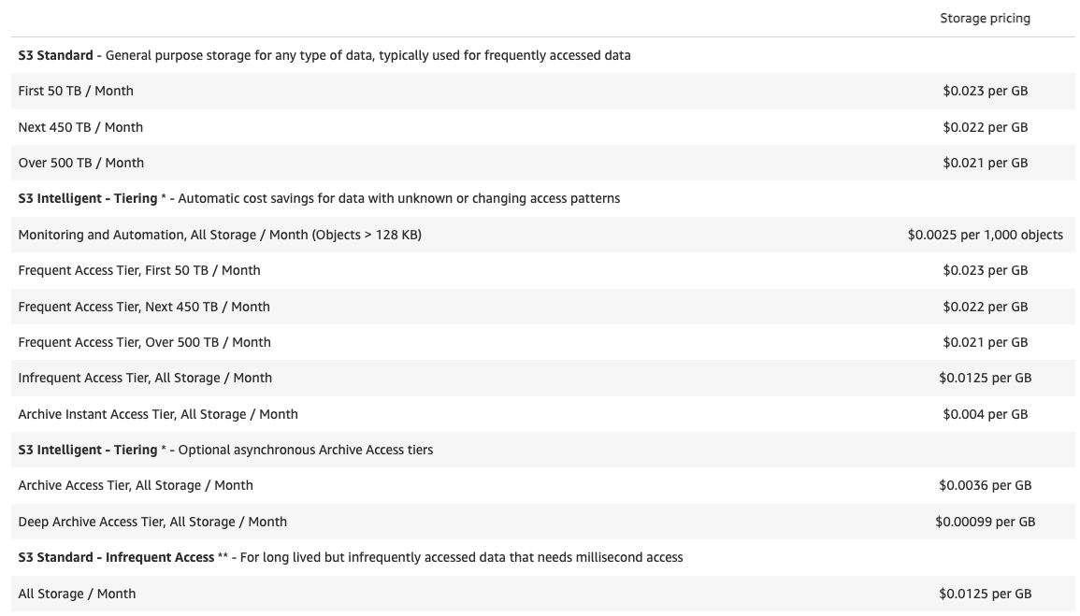
DynamoDB Streams

Slide 20
Event Driven

Slide 21
Batching Events…

Slide 22


FINALLY!
Time for
a break.

Slide 23

That’s it folks!
Thank you!

